Slide 1



Business 360
View in Power BI
Last data refresh:
6/1/2024 11:04:17 AM UTC
Downloaded at:
6/1/2024 11:10:16 AM UTC

Slide 2
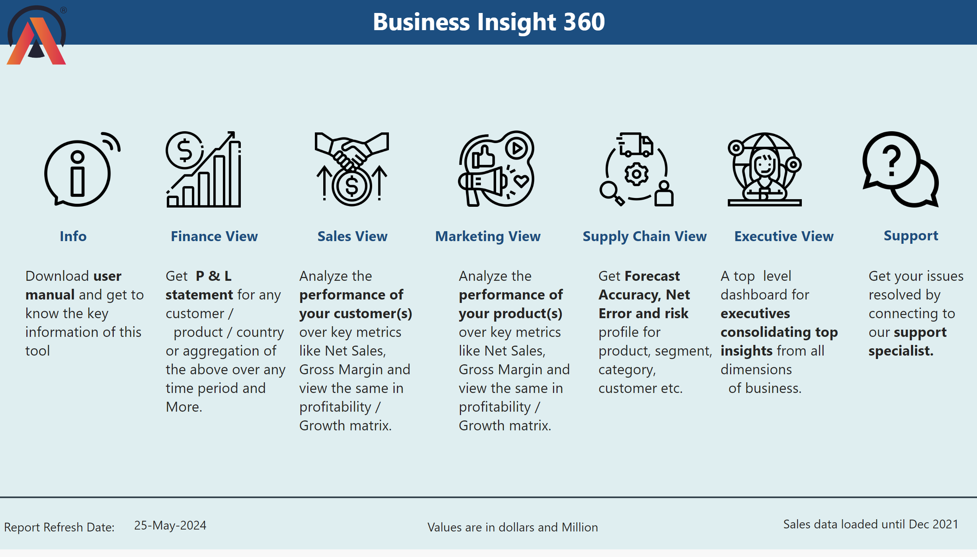
Home
Notes:
textbox
No alt text provided
image
No alt text provided
image
No alt text provided
image
No alt text provided
image
No alt text provided
image
No alt text provided
image
No alt text provided
image
No alt text provided
textbox
No alt text provided
textbox
No alt text provided
textbox
No alt text provided
textbox
No alt text provided
textbox
No alt text provided
textbox
No alt text provided
textbox
No alt text provided
textbox
No alt text provided
textbox
No alt text provided
textbox
No alt text provided
textbox
No alt text provided
textbox
No alt text provided
textbox
No alt text provided
textbox
No alt text provided
image
No alt text provided
shape
No alt text provided
card
No alt text provided
textbox
No alt text provided
card
No alt text provided
textbox
No alt text provided

Slide 3
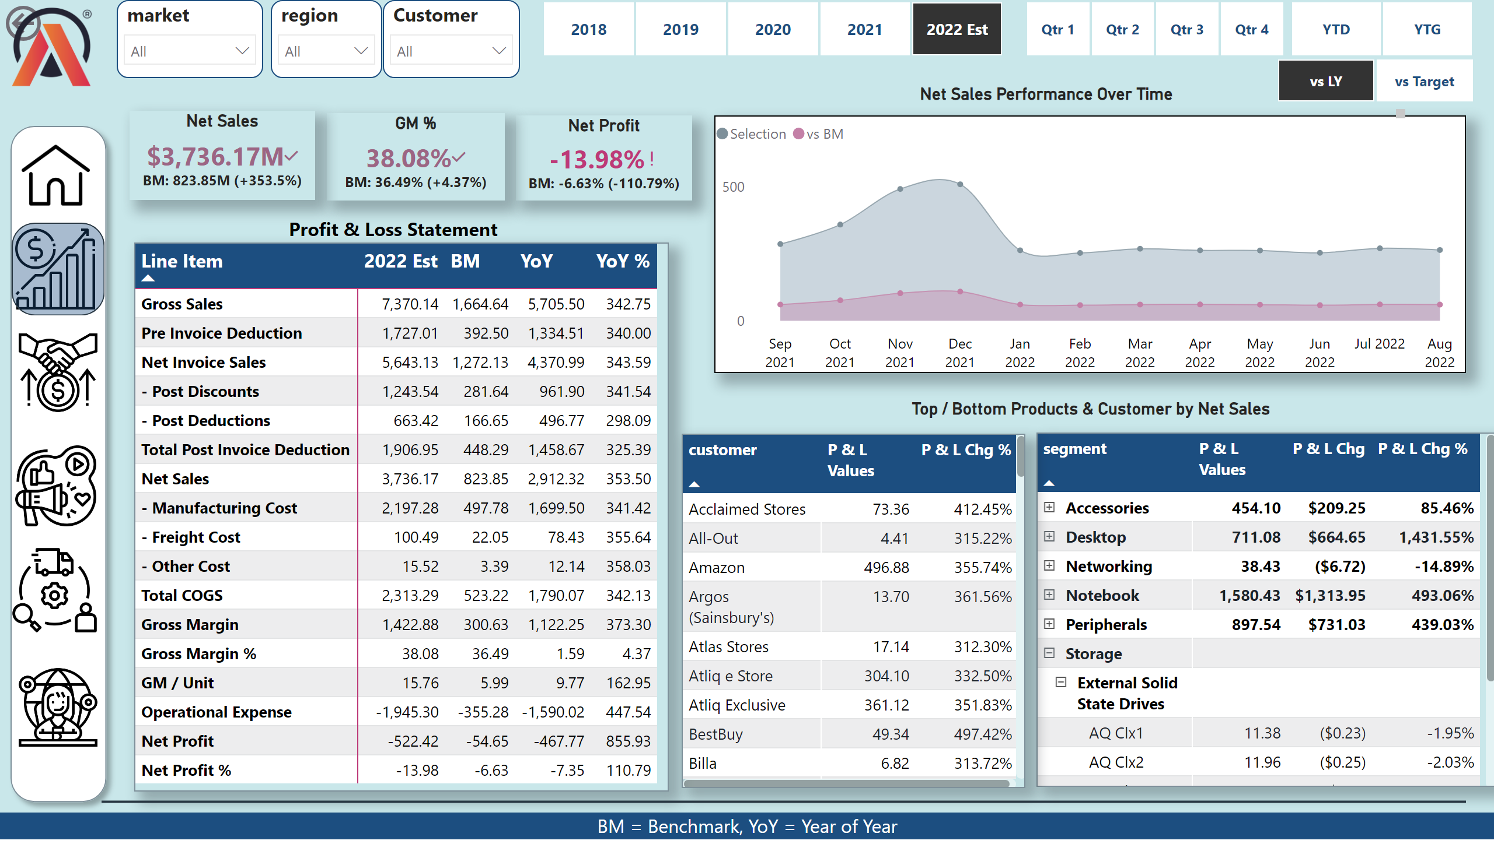
Financial View
Notes:
pivotTable
No alt text provided
actionButton
No alt text provided
slicer
No alt text provided
slicer
No alt text provided
slicer
No alt text provided
Net Sales Performance Over Time
No alt text provided
pivotTable
No alt text provided
pivotTable
No alt text provided
shape
No alt text provided
image
No alt text provided
image
No alt text provided
image
No alt text provided
image
No alt text provided
image
No alt text provided
image
No alt text provided
slicer
No alt text provided
slicer
No alt text provided
slicer
No alt text provided
Profit & Loss Statement
No alt text provided
Top / Bottom Products & Customer by Net Sales
No alt text provided
Net Sales Performance Over Time
No alt text provided
Net Sales
No alt text provided
GM %
No alt text provided
Net Profit
No alt text provided
shape
No alt text provided
image
No alt text provided
slicer
No alt text provided
card
No alt text provided
shape
No alt text provided
BM = Benchmark, YoY = Year of Year
No alt text provided

Slide 4
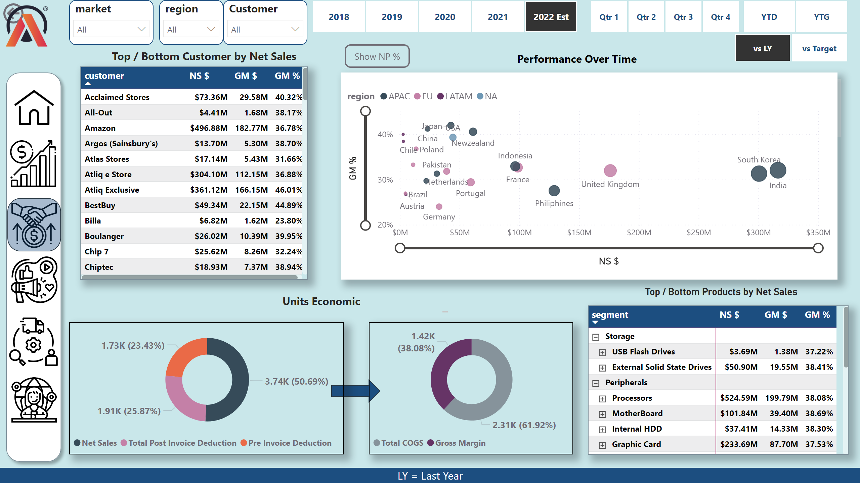
Sales View
Notes:
actionButton
No alt text provided
slicer
No alt text provided
slicer
No alt text provided
slicer
No alt text provided
shape
No alt text provided
image
No alt text provided
image
No alt text provided
image
No alt text provided
image
No alt text provided
image
No alt text provided
image
No alt text provided
slicer
No alt text provided
slicer
No alt text provided
slicer
No alt text provided
Top / Bottom Products by Net Sales
No alt text provided
Performance Over Time
No alt text provided
shape
No alt text provided
tableEx
No alt text provided
pivotTable
No alt text provided
shape
No alt text provided
donutChart
No alt text provided
donutChart
No alt text provided
Top / Bottom Customer by Net Sales
No alt text provided
image
No alt text provided
Units Economic
No alt text provided
slicer
No alt text provided
slicer
No alt text provided
NP % Button
No alt text provided
GM % Visual
No alt text provided
actionButton
No alt text provided
scatterChart
No alt text provided
LY = Last Year
No alt text provided

Slide 5
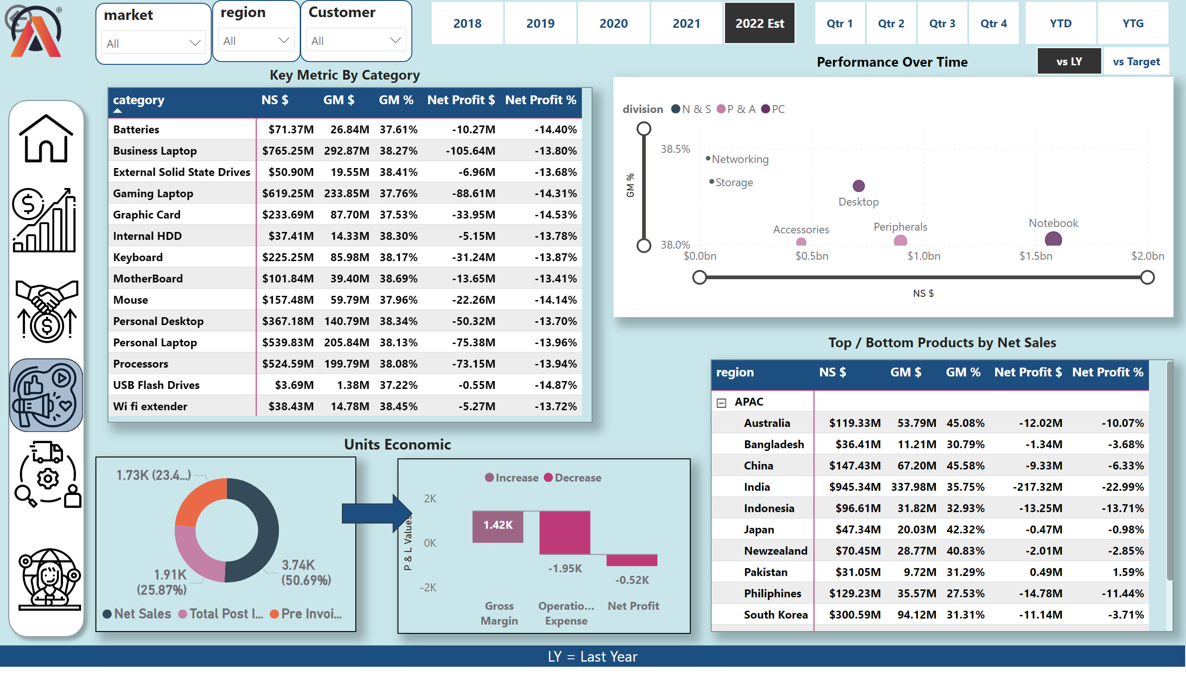
Marketing View
Notes:
actionButton
No alt text provided
slicer
No alt text provided
slicer
No alt text provided
slicer
No alt text provided
shape
No alt text provided
image
No alt text provided
image
No alt text provided
image
No alt text provided
image
No alt text provided
image
No alt text provided
image
No alt text provided
slicer
No alt text provided
slicer
No alt text provided
slicer
No alt text provided
Top / Bottom Products by Net Sales
No alt text provided
Performance Over Time
No alt text provided
shape
No alt text provided
donutChart
No alt text provided
Key Metric By Category
No alt text provided
scatterChart
No alt text provided
pivotTable
No alt text provided
waterfallChart
No alt text provided
pivotTable
No alt text provided
shape
No alt text provided
image
No alt text provided
Units Economic
No alt text provided
LY = Last Year
No alt text provided
slicer
No alt text provided

Slide 6
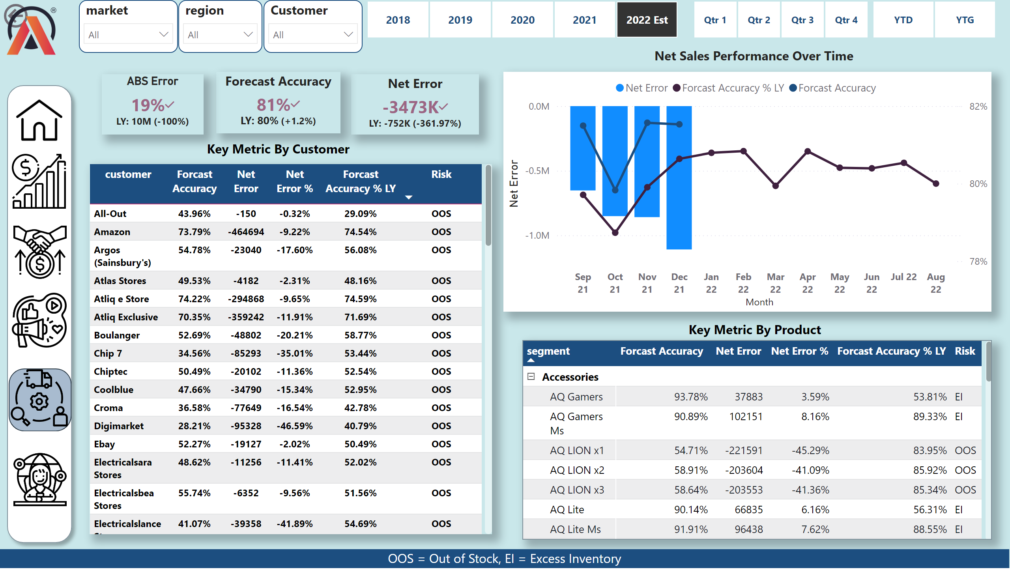
Supply Chain View
Notes:
actionButton
No alt text provided
slicer
No alt text provided
slicer
No alt text provided
slicer
No alt text provided
shape
No alt text provided
image
No alt text provided
image
No alt text provided
image
No alt text provided
image
No alt text provided
image
No alt text provided
image
No alt text provided
slicer
No alt text provided
slicer
No alt text provided
slicer
No alt text provided
Key Metric By Customer
No alt text provided
Net Sales Performance Over Time
No alt text provided
Forecast Accuracy
No alt text provided
Net Error
No alt text provided
ABS Error
No alt text provided
shape
No alt text provided
tableEx
No alt text provided
pivotTable
No alt text provided
lineStackedColumnComboChart
No alt text provided
image
No alt text provided
Key Metric By Product
No alt text provided
OOS = Out of Stock, EI = Excess Inventory
No alt text provided

Slide 7
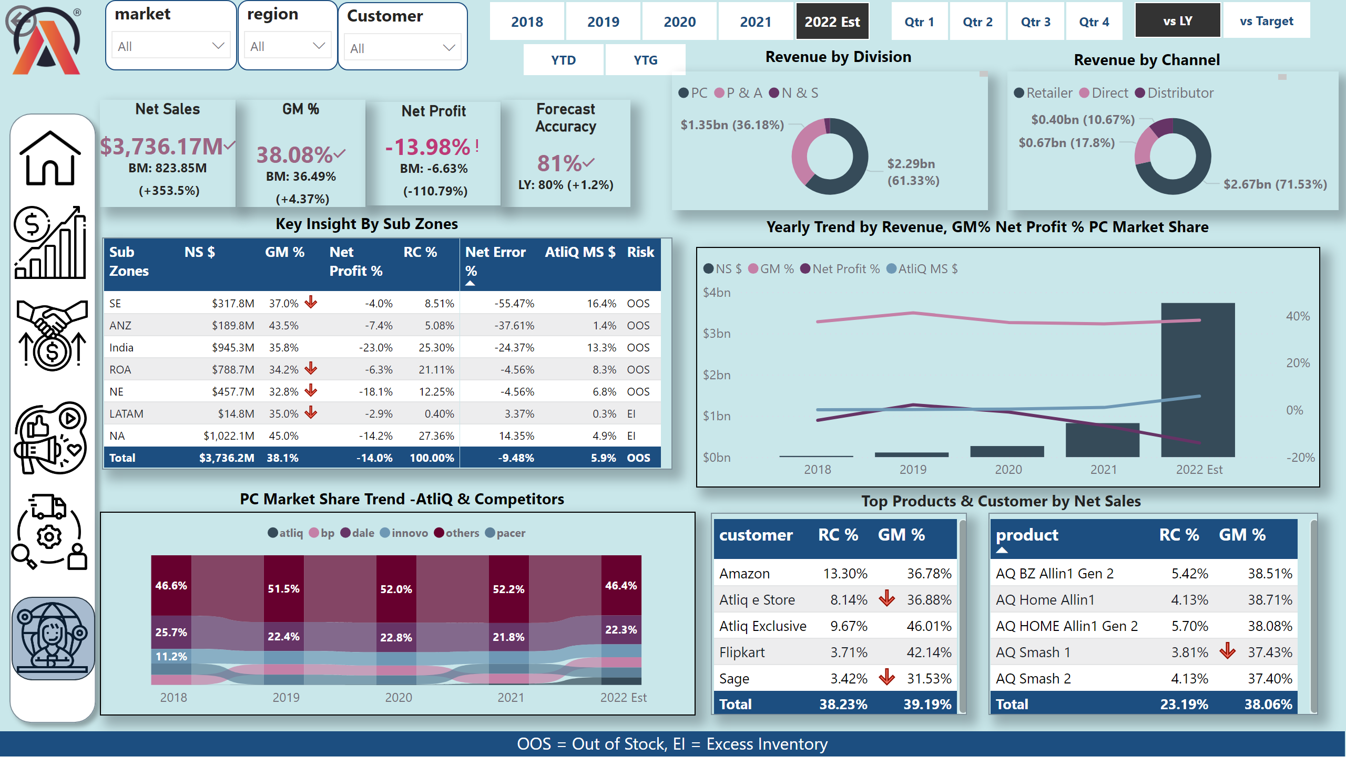
Executive View
Notes:
actionButton
No alt text provided
slicer
No alt text provided
slicer
No alt text provided
slicer
No alt text provided
shape
No alt text provided
image
No alt text provided
image
No alt text provided
image
No alt text provided
image
No alt text provided
image
No alt text provided
image
No alt text provided
slicer
No alt text provided
slicer
No alt text provided
slicer
No alt text provided
Key Insight By Sub Zones
No alt text provided
Top Products & Customer by Net Sales
No alt text provided
Net Sales
No alt text provided
GM %
No alt text provided
Net Profit
No alt text provided
shape
No alt text provided
image
No alt text provided
slicer
No alt text provided
card
No alt text provided
Forecast Accuracy
No alt text provided
donutChart
No alt text provided
donutChart
No alt text provided
Revenue by Division
No alt text provided
Revenue by Channel
No alt text provided
tableEx
No alt text provided
lineStackedColumnComboChart
No alt text provided
PC Market Share Trend -AtliQ & Competitors
No alt text provided
ribbonChart
No alt text provided
tableEx
No alt text provided
tableEx
No alt text provided
Yearly Trend by Revenue, GM% Net Profit % PC Market Share
No alt text provided
OOS = Out of Stock, EI = Excess Inventory
No alt text provided

Slide 8
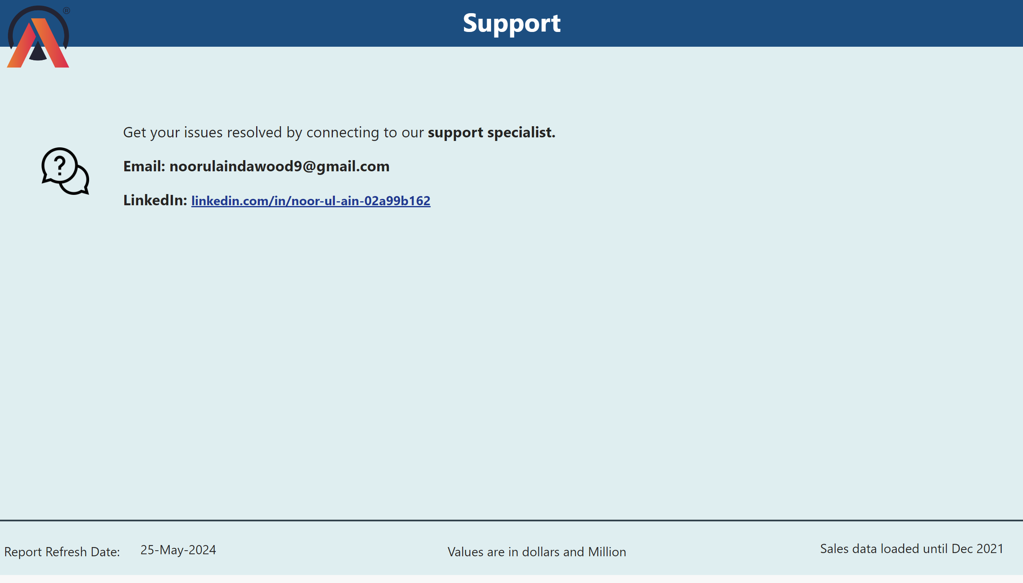
Support
Notes:
textbox
No alt text provided
image
No alt text provided
textbox
No alt text provided
image
No alt text provided
shape
No alt text provided
card
No alt text provided
textbox
No alt text provided
card
No alt text provided
textbox
No alt text provided

